Slide 1


Core Architectural Pattern
The Layered Model
Rob Vettor and John Mason Developer Consultants Microsoft Premier Developer Practice
June 2014

Slide 2










Why we are here?
Microsoft Confidential
Layering Tiers
Loose Coupling
Key Takeaways
Understand the need and benefits to decomposing an application into logical layers
2

Slide 3








The Layered Architectural Pattern
S
eparation of
concerns/responsibilities (referred to as SoC)

Slide 4


The Layered Architectural Pattern
S
Different levels of abstraction Substantial concerns that are coherent Issues…
No standard granularity
Complex components may need more decomposition Performance issue going through layers
Error handling complexity Arbitrary layering criteria Favors Interface-based design

Slide 5







Layering Example
S

Slide 6


Layering How To’s
Decompose application into logical groupings of software components – called layers
Differentiate components by tasks performed
Two main approaches to separation:
Layers – logical separation where layers reside on same tier or server
Often these CAN be separated on more servers if needed,
i.e. provides Horizontal Scalability.
Tier - physical distribution of the functionality and components on separate servers, computers, networks, or remote locations

Slide 7
Simple Layered (Multitier) Model

Slide 8
More Complex Layered (Multitier) Model

Slide 9
Complex Layered Multitier Model

Slide 10
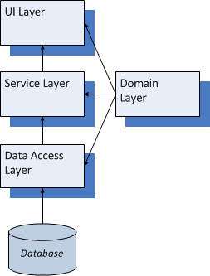
Example Music Store - Layering

Slide 11
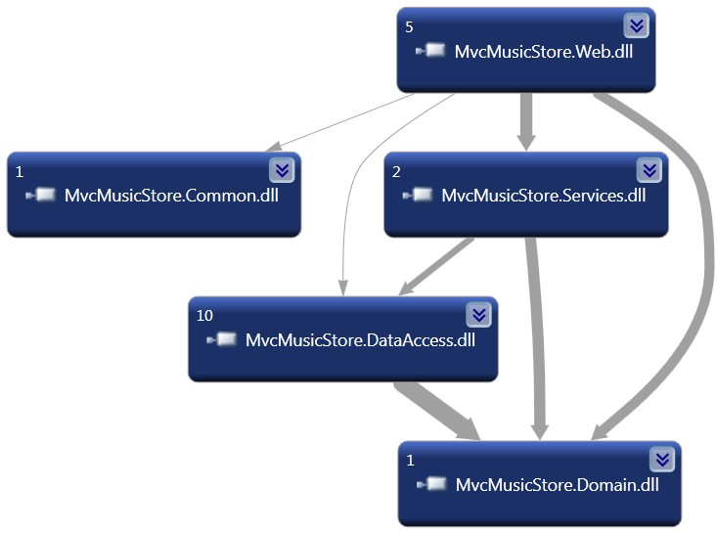
Example Music Store - Dependencies

Slide 12








Loose Coupling
Implement Interfaces to communicate across layers --
enforces loose coupling
A layer should not expose internal details on which another layer could depend
Controller, Services, Repositories all loosely coupled with interface references
Controller has dependency on Service - interface-based
Service has dependency on Repository - interface- based
Repository has dependency on DbContext
One Layer can Mock or Fake another layer to isolate functionality in order to create unit tests…

Slide 13
Demo
MVC Music Store Layering

Slide 14
Questions? Comments?

